Slide 1
Promoting your church
Church Websites and Social Media – the Basics.
By Rev. Matt Mirabile

Slide 2
I know, you have a website.

Slide 3
Are you sure?

Slide 4
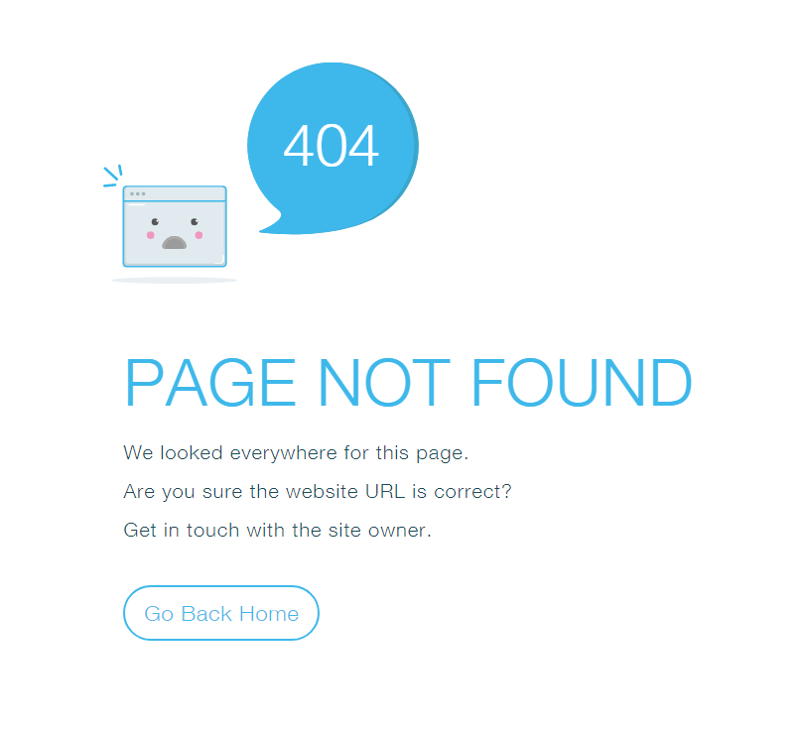
really?

Slide 5
Can you be found? If you can’t be found on google maps you don’t exist!

Slide 6
Claim your business!

Slide 7
The above examples illustrate:
Pastors are not paying attention to their websites.
1
Pastors are not thinking enough about growth.
2
Pastors are taking the work of others for granted.
3
Vicar, Rector, Father, Deacon – it is your responsibility to make sure people can find you.
4

Slide 8
But I’m not a web-designer!
You may not be a web designer (and no one expects you to be one) but you do need to know enough about creating your church’s website that you can direct and correct the work of others who are charged with creating your website.
It is likely that the person who volunteers to create and manage your website will not be a professional website designer. This is why it is so important for you to be able to help guide them in the design and management of your website. Your church may depend on it.

Slide 9
You are not alone And your competition will eat you alive!

Slide 10
Your church website
Beginning to think about your website:
Why is it important?
Who is it for?
What should it include?
How should it look?
What should it say?
What should it do?
How should it work?

Slide 11
Not the yellow pages So what is the purpose of a website?
The internet is not the equivalent of the yellow pages.
People are not attempting to “find a church” as they did in the old days. Then, they would open the book, find their denomination, look for a church address nearby and go visit to learn more.
Those days are long gone. That is not what your website is for.
So what is the purpose of a website?

Slide 12
Growth strategy “Pray like it all depends on god, work like it all depends upon you.”
Your church website is just one part of a growth strategy. You have had strategies about managing your finances, your healthcare, your career. Not having a strategy for growing your church is almost gnostic.
Your church growth must align with your website. If your mission is not ready for prime time. Wait. Getting visitors prematurely can actually kill your mission if your visitor experience is negative.
It goes without saying, your website will either help or hurt your mission. It is not neutral!

Slide 13
Ready for growth? have you done an assessment?
Are you committed to grow? Having a website does not automatically grow your church. It is just one cog in the wheel. Are you ready to grow?
Do you have the energy to grow the church?
Do you have the time?
Is it your priority? Or a hobby?
Do you have a willing core group?
Are they equipped to support growth? Are you?
Are you located in a place that helps or hurts growth?
Who are you likely to attract?
Who do you want to attract?
What can you change, without sacrificing essentials, for meaningful growth?

Slide 14
Who is looking? Seekers.
Who is looking for your church? Unhappy Episcopalians? Lapsed Catholics? Young families?
Chances are, the people looking for your church are not looking for your church, but a church in your area - A church that resonates with them in some way. But they are not going to go visit you first. Their first exposure to you will be through your website.

Slide 15
Who are you reaching? demographics
Have you thought about who you want or need to attract to your church?
What is the demographic profile of your area?
How can you speak to those concerns?
In order for a church to continue to thrive it must attract young families with children. Are you reaching them?
The design of your site, and parish efforts, should take all of this into consideration.

Slide 16
Who is your website for? Preparing the virtual visit
Now that you have thought about who might be looking for your church, who you are best suited to reach, and who you want to reach better, you are ready to create a website for them.
Your website, therefor, is not primarily for your parishioners, or other Anglicans. It is for inquirers, for seekers. It is for people who are looking to connect with God.
Now that they have found you online, what will they think about your church?
Have you looked at your website through the eyes of your seeker audience?

Slide 17
A Virtual visit Your website provides seekers a virtual visit to your church. It should answer these eight questions:
What’s your church like? Do I fit?
What’s the pastor like? Would I connect?
What do you do? Is it meaningful?
Will my kids be taken care of?
How can I serve?
Can I find purpose?
What do you believe? Does your ethos capture me?
When do you meet?
Is it convenient?
How do I connect? Where are you – Brick and Social media?
Notes:
Answer all of these well and your website should result in a stream of visitors. Answer them poorly and you might as well not have a website.

Slide 18
Defining expectations The credibility quotient
“Online experiences define the brand. The website experience now sets user expectations for all other interactions with the company.” AIA
01
Your church website does not exist in a vacuum, it is competing with many other websites. Considering that potential visitors will see your website and compare it to others, what will they infer about your church?
02
Credibility is capitol. If your website is poor it undermines your credibility. You website is a credibility machine.
03
Notes:
Do you want to beat out the local Episcopal or Congregational church? Look more credible than they.

Slide 19
One primary job! produce visitors
1
If your website does not answer the above objectives in a compelling and engaging way it has failed.
Your website has to fail to answer only two or three of these questions before the person writes you off and looks elsewhere.
If your website does not do this one thing, it is a waste of time and energy. Improve it until it produces this result.
The natural result of a well-designed church website is visitors.

Slide 20
First impressions The home page
Google and Microsoft Research both report that most people spend 10 seconds or less on your home page before making the decision to hit the back button or to look around more.
Your first page must form an emotional connection with the seeker that drives them to learn more on subsequent pages.
I like
You

Slide 21
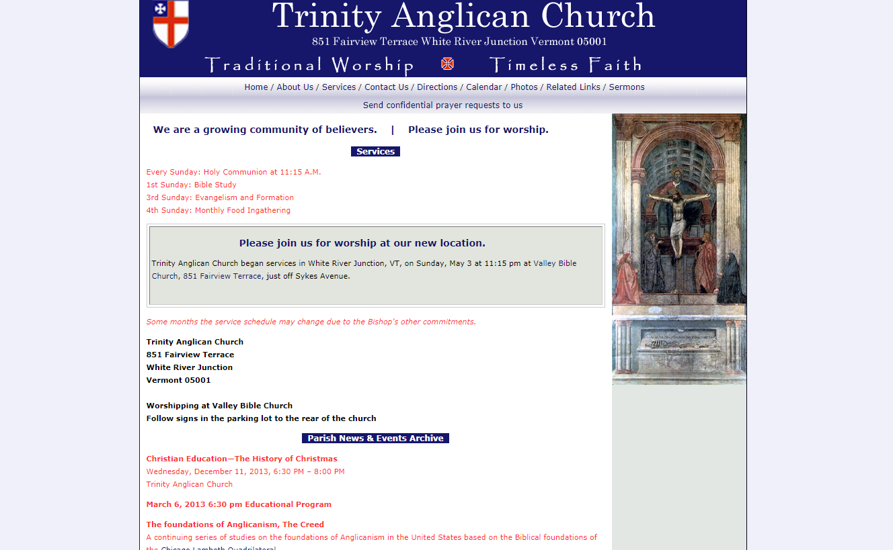
Emotional connection?

Slide 22
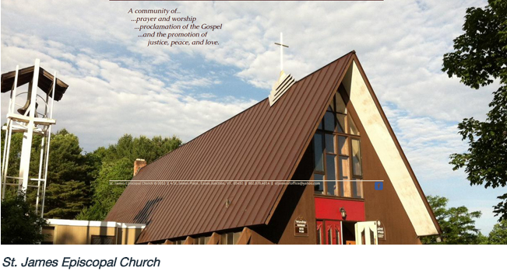
Inspire me at least a little

Slide 23
Draw me in

Slide 24
can I see myself

Slide 25
Touch my heart

Slide 26
Its about People

Slide 27
Good Design Templates, photos and colors
4
There are four main components that make for good web design:
The Template (provided by the service you choose)
The Color Theme (typically chosen with the template)
Good Photos (provided by service and/or yourself)
Consistent, readable, and interesting text (chosen with the template)
Notes:
I know, you are not a web designer. Neither am I.
If you are not color coordinated, find someone who is.

Slide 28
What it should do the homepage and beyond
Your home page should make people feel good and connect them to your people and your ethos.
Remember the church is people, its not a building!
1
It should connect them with meaning and purpose.
It should inspire them. It should inform them. It should make them curious. It should educate them – a little.
2
A good homepage should drive people to discover more of the content on your site.
It should guide visitors along a path in your site.
3
It should make them want to visit.
4

Slide 29
What should it say?
It should tell them that you care about people.
It should create interest, curiosity and Inspiration.
It should explain what they can expect when they visit, allaying fears.
It should tell them that you are doing meaningful things – and they can too!
It should tell them when Sunday services are.
It should tell them where you are.
It should tell them your associations and acquaint them with your clergy.
It should keep them informed and returning to learn more about you.

Slide 30
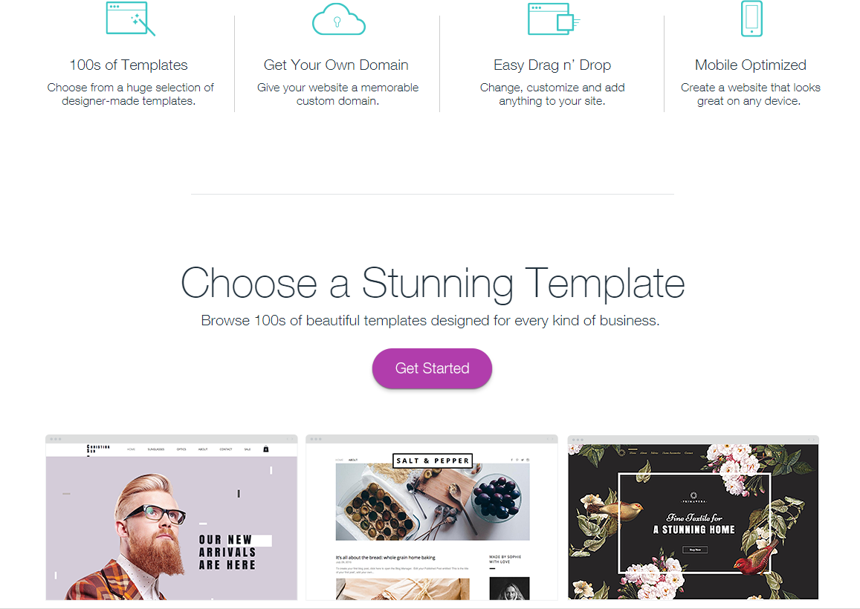
Getting started start, design and maintain
Whether you choose Squarespace, Weebly, Wix or Wordpress they all follow a similar start up and creation process. They will walk you through it.
Costs will range from $14 dollars per month to $24, depending on features.
Don’t forget to migrate your domain name to your new hosting service. They can make this process easy.

Slide 31
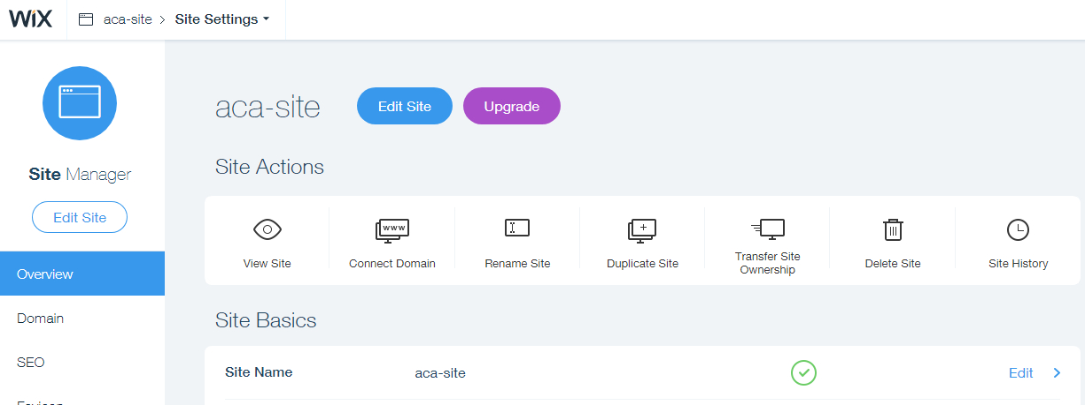
How it works
The Back End

Slide 32
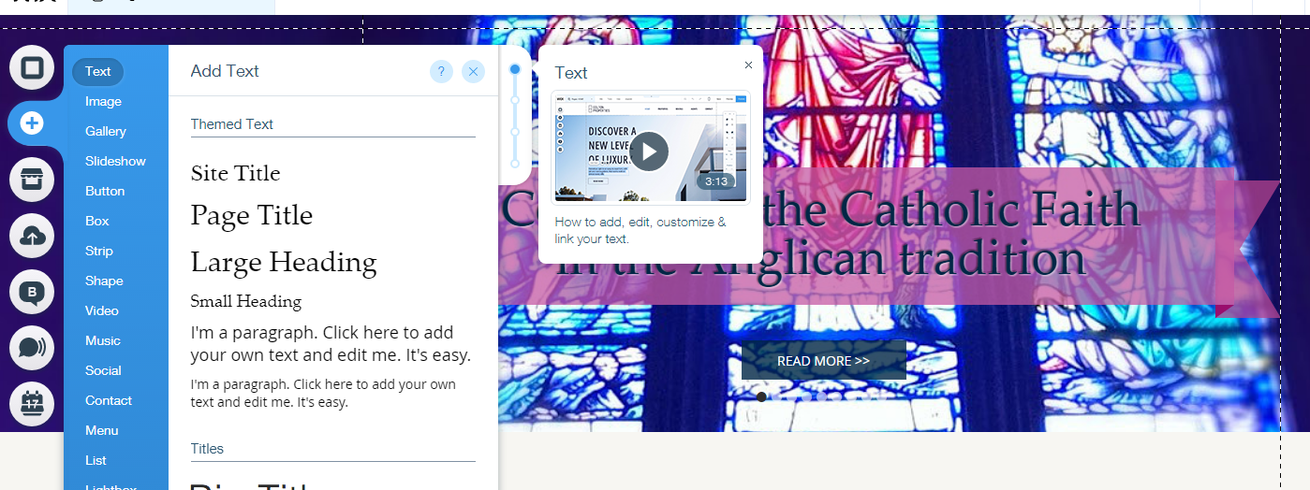
Easy Content management
Adding Elements

Slide 33
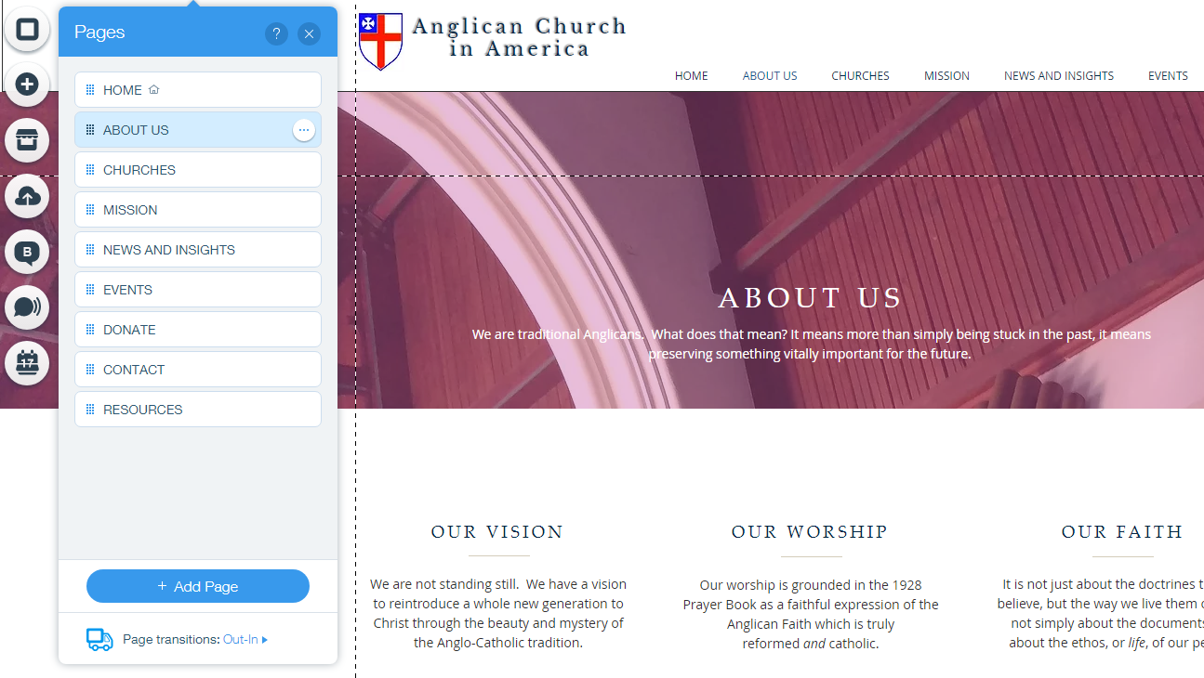
Easy Content management
Menu Creation and Pages

Slide 34
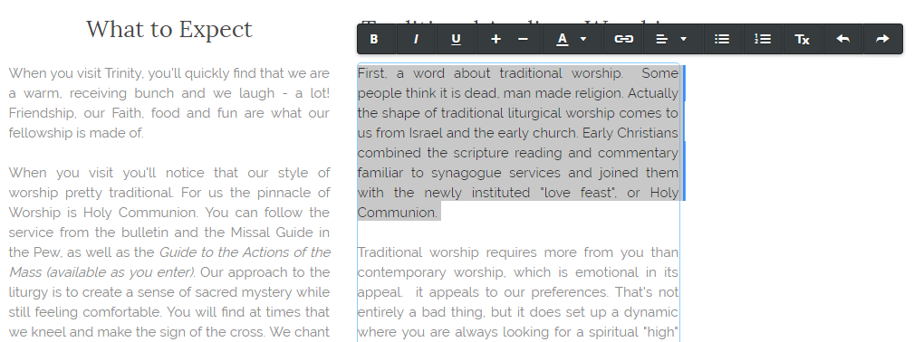
Easy Content management
Familiar Text Editing

Slide 35
Content keeping it alive
One you have designed your website you are ready to publish it. Simply click “publish”, and your site will be “live”. You will need to do this after every update, change, new article or edit.
01
The trick to keeping your website working for you is to update the content on a regular basis. Every site should have a “blog page” that is used to post articles and insights on a regular basis.
02
There are two reasons why you want to update content regularly. One, to draw curious inquirers back to your site to find out what’s happening. Two, web-crawlers (bots) take note of when sites are inactive and will eventually drop them lower on search result priorities.
03

Slide 36
Using Social media
Using facebook to:
Communicate your vision
Enlarge your audience
Engage new people
Encourage your people

Slide 37
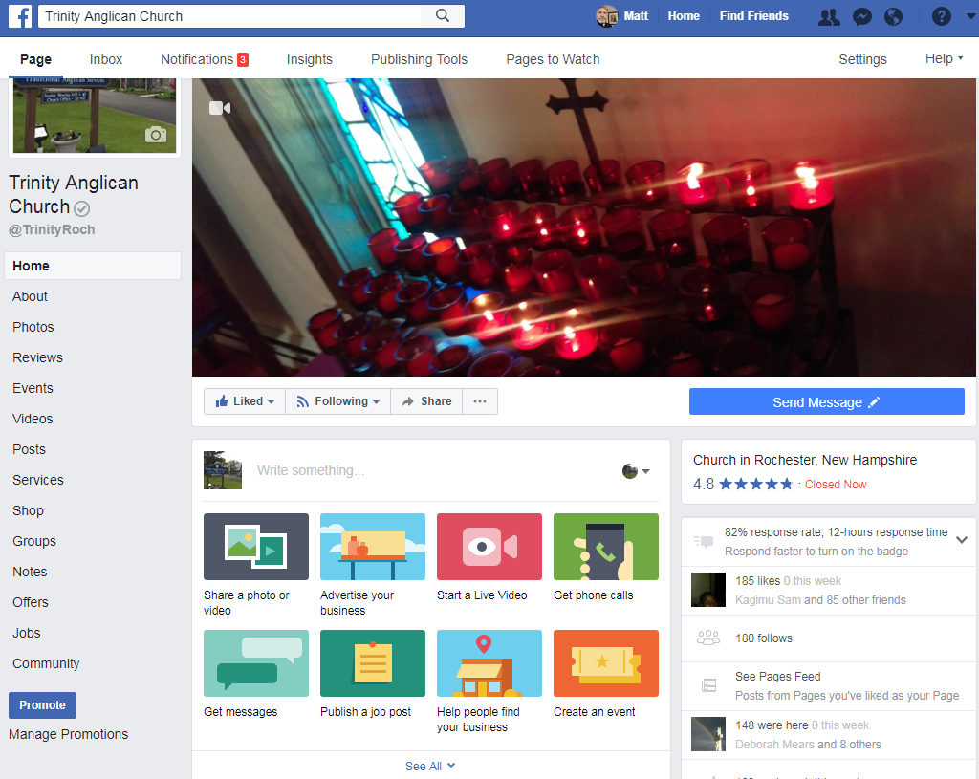
Facebook social networking
Facebook is a social platform designed to connect people along natural social networks. It was originally designed to introduce college students to one another.
Fast-forward to today and facebook is now the marketing and information giant, exploiting the internet for powerful network marketing.
What this means for you is that you are now able to bypass traditional advertising and marketing methods and have the “customer” invite you into their world.

Slide 38
Facebook social networking
You want to use facebook to grow your church. This is not automatic. It is the result of exploiting what facebook is good at, social connections.
Facebook makes it easy for people to find and engage things that interest them. Your job is to create an online identity that creates interest and causes people to “like” and “share” your vision, your church, your mission. In turn, this will eventually lead people to engage with your church online, create interest, and eventually visit your church.

Slide 39
Facebook Prying open your community
Facebook gives you various tools to connect with people outside of your network.
People who know your church can “friend” you and you can invite people you know to “friend” the church. You can share a photo of your church or an event, advertise your church event, livestream a video, publish posts or create an event. As people in your network “like”, or “share” these others outside of your immediate network will see their activity on their “feed”.
(a feed is a running display of activity based on engagements within that persons networks)

Slide 40
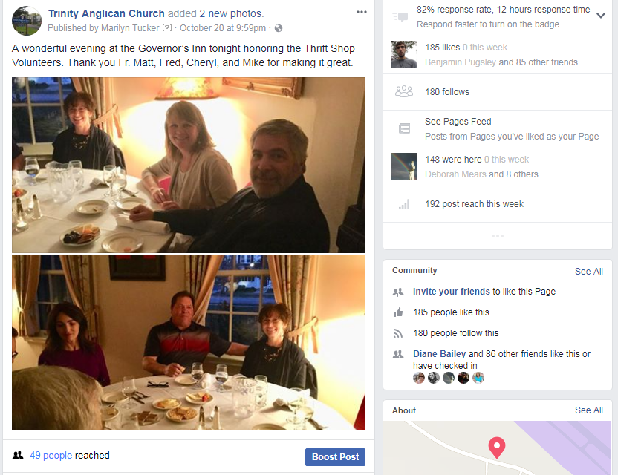
Facebook Social Networking
Posting photos and events important to your church enlarges your audience and allows you to present your church to more people.
You want to share all the good things you are doing with the world.

Slide 41
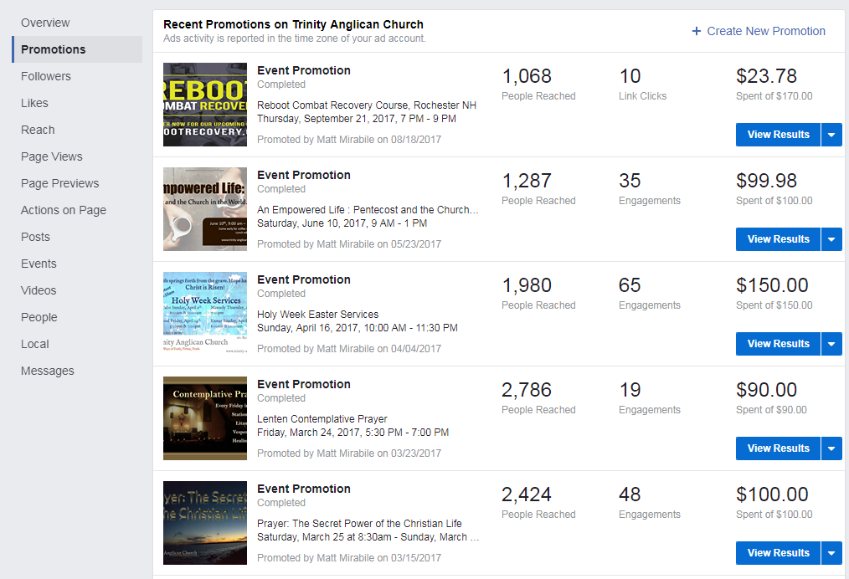
Promoting events
Facebook provides you an advertising platform to promote your events and services.
You can choose the radius from your location to determine what areas you want to reach, you can chose what age groups, and interests as well. Each of these choices allow you to promote your event to people who may be more likely to have an interest in your activity.

Slide 42
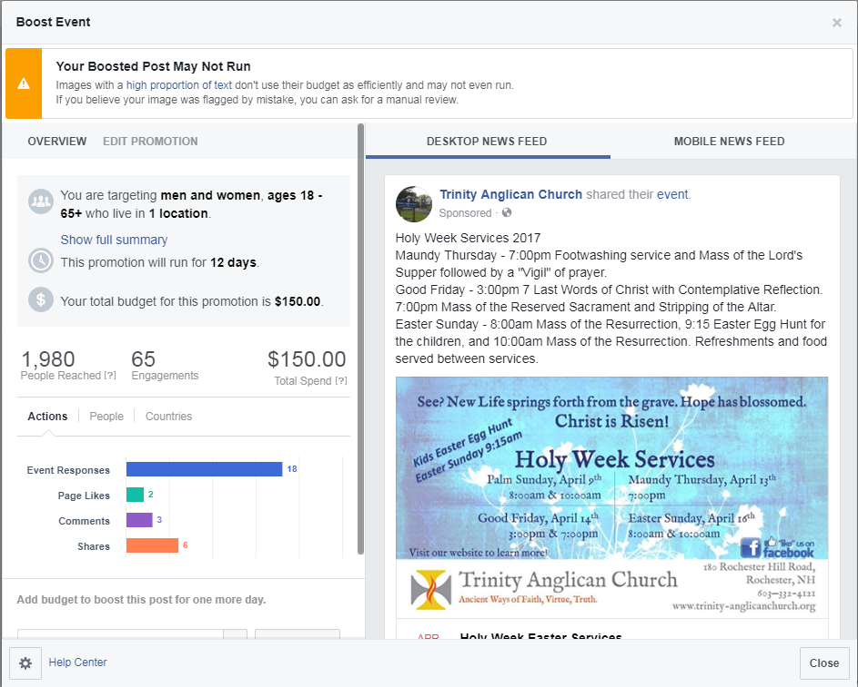
Promoting events
Facebook also provides data so that you can see how many have been reached, how many engaged your add, and who has responded to your add. You can then invite them to “like” or “friend” your page so that your posts display in their feed on a regular basis.

Slide 43
Facebook social networking
You can:
Live Stream your services
Post short video bible studies
Post passages of scripture or meditations
Make announcements about services and cancellations.
You can even use your facebook page to monitor the emotional and spiritual wellbeing of parishioners.

